Slide 1
OBI/CL/CLO Alignment
Jie Zheng

Slide 2
High Level Terms
cell (CL_0000000)
  native cell (CL_0000003)
  cell in vitro (CL_0001034)
    cell culture cell (CL_0000010) – cell line cell (OBI_0100055)
    permanent cell line cell (CL_0000002) - immortal cell (OBI_0100035)
cell line (CLO_0000001) – cell culture (OBI_0100060)
  primary cell line (CLO_0000019) – primary cell culture (OBI_0100061)
  permanent cell line (CLO_0000018) – immortalized cell line culture (OBI_0100056)
establishing cell culture (OBI_0600036)
cell line culturing (CLO_0000000)

Slide 3
Generate Slims
Containing all the terms address in previous slide
Using fibroblast as cell example
Using Hela cell line as cell line example
Slim generated using ontodog
  OBI_slim.owl, CL_slim.owl, CLO_slim.owl

Slide 4
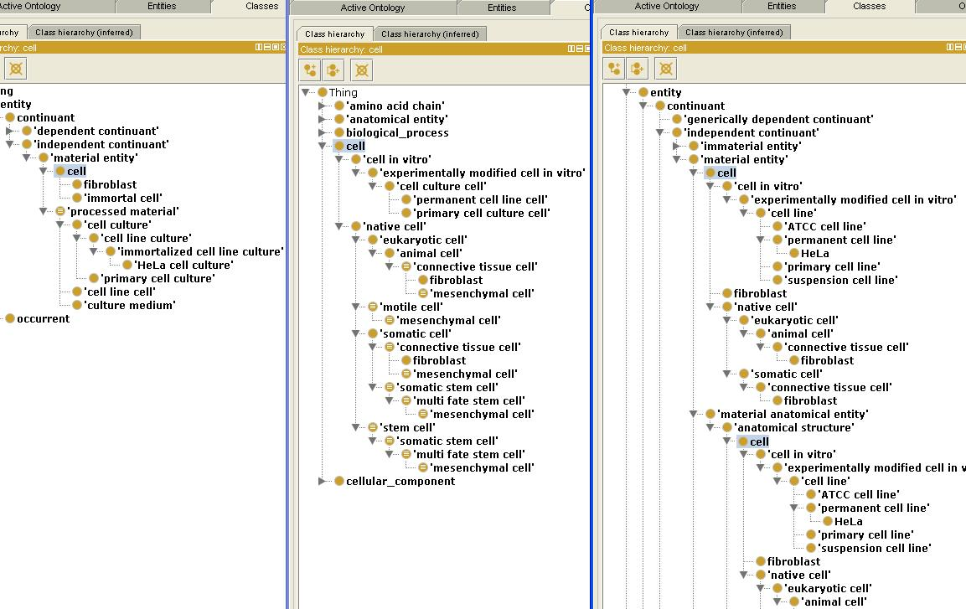
Hierarchy of Cell
OBI
CL
CLO
Subclasses of cell
- native cell
- cell in vitro
Parent class of cell
- material entity
- anatomical structure (CARO)
Question:
If cell is a subclass of anatomical
structure, it cannot be cell in
vitro.
ClO needs to be cleaned up

Slide 5
Cell
Parent of Cell
  Material entity
  Anatomical structure
Subclasses of Cell
  Native cell
  Cell in vitro

Slide 6
Hierarchy of Cell in vitro
OBI
CL
CLO
CLO imports CL: cell in vitro
OBI has some concepts similar to some subclasses of
CL: cell in vitro

Slide 7
Cell in vitro
permanent cell line cell (CL_0000002)
  A cell culture cell that is part of a cell line having the capacity to proliferate indefinitely if given appropriate space and nutrients.
immortal cell (OBI_0100035)
  a cell derived from a multicellular organism that has the potential to replicate indefinitely. (example: a single Hela cell)
Question: replaced by CL term?
primary cell culture cell (CL_0000001)
  A cell culture cell that is part of a cell culture that does not have the capacity to proliferate indefinitely.
cell line cell(OBI_0100055)
  A material entity that represents generations of a primary culture.
  'processed material' and is_specified_output_of some 'establishing cell culture‘
  OBI: 'establishing cell culture‘ has_specified_output some 'cell culture‘ (not ‘cell line cell’)
Not so clear about the OBI term, looks like CL:primary cell culture cell
Suggestion:
OBI imports ‘native cell’ and ‘cell in vitro’ and its subclasses

Slide 8
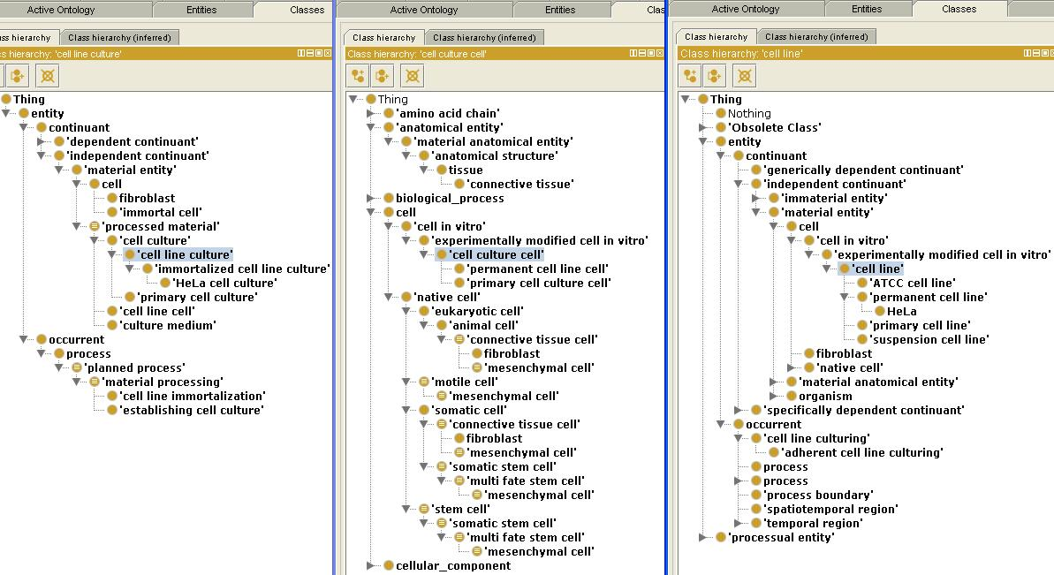
Hierarchy of Cell Line/Cell Culture
OBI
CL
CLO
Question:
CLO: cell line refer to a single cell or a collection of cells growing in some specific condition?

Slide 9
OBI:Cell Culture / CLO:Cell Line
cell culture (OBI_0100060)
  a cell culture is a material entity consisting of a population of cells that is maintained in vitro
  'has grain' some cell
  is_specified_output_of some 'establishing cell culture‘
  Subclass: cell line culture, clonal cell culture, primary cell culture
Cell line (CLO_0000001)
  A cell line is an experimentally modified cell in vitro that can be passaged in vitro without characteristics changes in the next generation.
Question
  CLO: cell line refer to a single cell or a collection of cells growing in some specific condition

Slide 10
Subclasses of Cell Culture
Cell culture has subclasses cell line culture, primary cell culture and clonal cell culture
cell line culture (OBI_0100062)
  a cell line culture is a cell culture where the cells grown are from a cell line, long term culture of cells that are replicating continuously. The cell population is homogenous but not clonal.
  Subclass: immortalized cell line culture (OBI_0100056)
    An immortalized cell line is a cell line that is able to replicate indefinitely as a result of an in vitro cell line immortalization process
    is_specified_output_of some 'cell line immortalization'
permanent cell line (CLO_0000019) ?= immortalized cell line culture (OBI_0100056)
  a cell line that can be passaged in an infinite number of generations.
Question
  permanent cell line (CLO_0000019) ?= immortalized cell line culture (OBI_0100056)
primary cell culture (OBI_0100061)
  a primary cell culture is a cell culture where the cells derive from a fresh tissue source.
primary cell line (CLO_0000018)
  a cell line that can be passaged in a finite number of generations.
Question
  any relation between primary cell line and primary cell culture?

Slide 11
Related Processes
establishing cell culture (OBI_0600036)
  establishing a cell culture is a process which results in creating an in vitro environment in which cells are sustained from input material containing cells. input: cell-containing material, output cell culture, part of cell culturing. Cells are originally plated at a certain concentration referred to as seeding density.
  has_specified_input some 'culture medium‘
  has_specified_input some cell
  has_specified_output some 'cell culture‘
cell line immortalization (OBI_0000877)
  is the planned process of experimentally creating a cell line which is capable of dividing indefinitely in vitro. Has specified output cell line
  has_specified_output some 'immortalized cell line culture'
cell line culturing (CLO_0000000) (no definition)

